Slide 1
JS Final Project
0612005 林政誠
0612020 吳峻陞
1

Slide 2
Outline
Tools & Env
Flow
Functionality & Coding Structure
4. Demo
2

Slide 3
Outline
Tools & Env
Flow & Functionality
3. Coding Structure
4. Demo
3

Slide 4
Tools & Env
html, javascript, css, bat
VS code, Notepad++, Node js, OS
4

Slide 5
Outline
Tools & Env
Flow
Functionality & Coding Structure
4. Demo
5

Slide 6
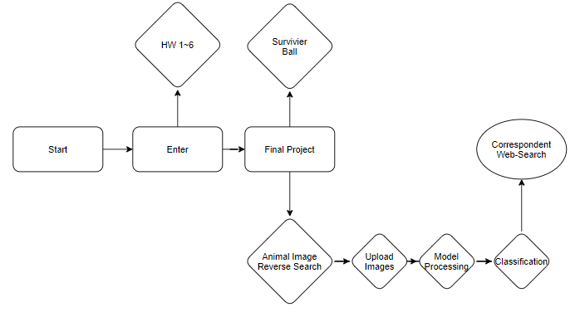
Flow
6

Slide 7
Outline
Tools & Env
Flow
Functionality & Coding Structure
4. Demo
7

Slide 8
Functionality & Coding Structure
Coverage => start.html
Transmission => enter.html / hw.html
Game => game.html
Animal Image Reverse Search => Search.html
8

Slide 9
Functionality
Functionality & Coding Structure
Coverage => start.html
Transmission => enter.html / hw.html
Game => game.html
Animal Image Reverse Search => Search.html
9

Slide 10
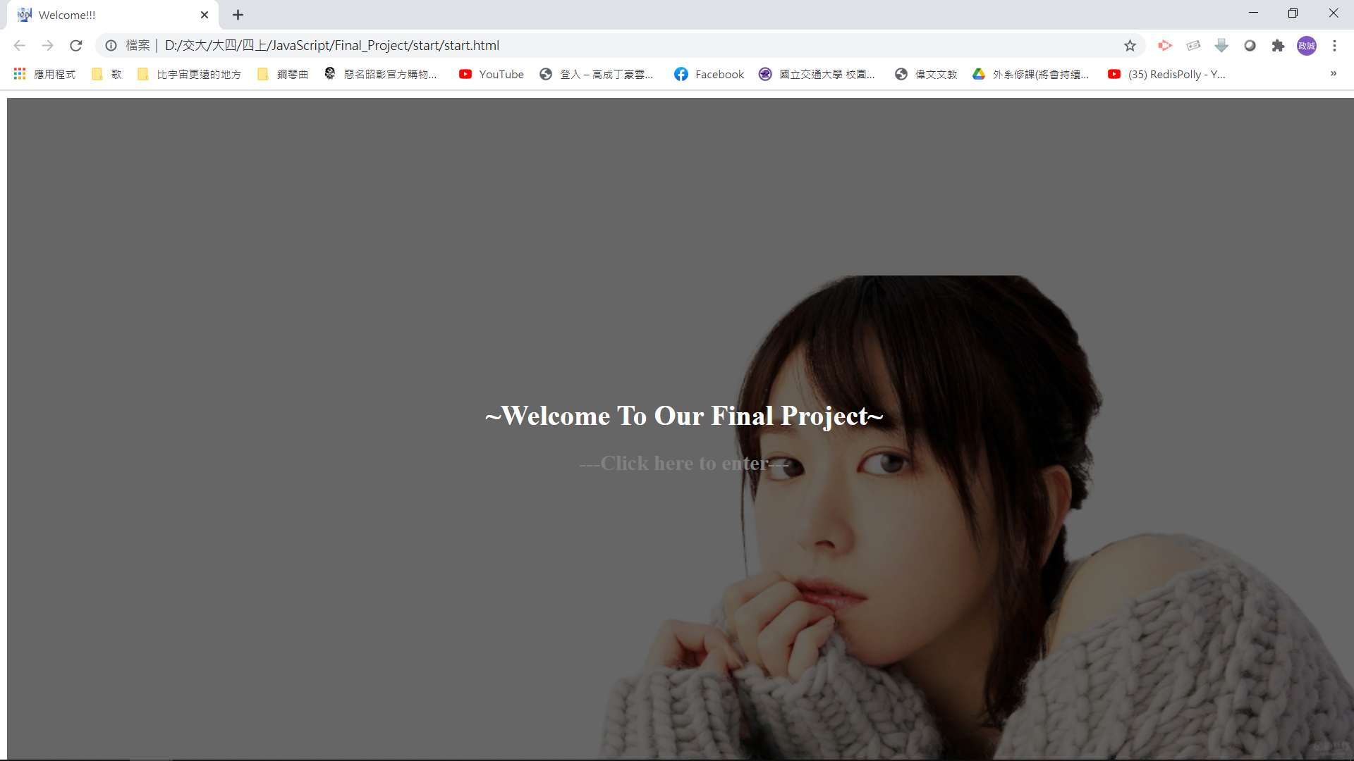
start.html/css
rgba(0, 0, 0, 0.6)
a href
:active
10

Slide 11
Functionality
Functionality & Coding Structure
Coverage => start.html
Transmission => enter.html / hw.html
Game => game.html
Animal Image Reverse Search => Search.html
11

Slide 12
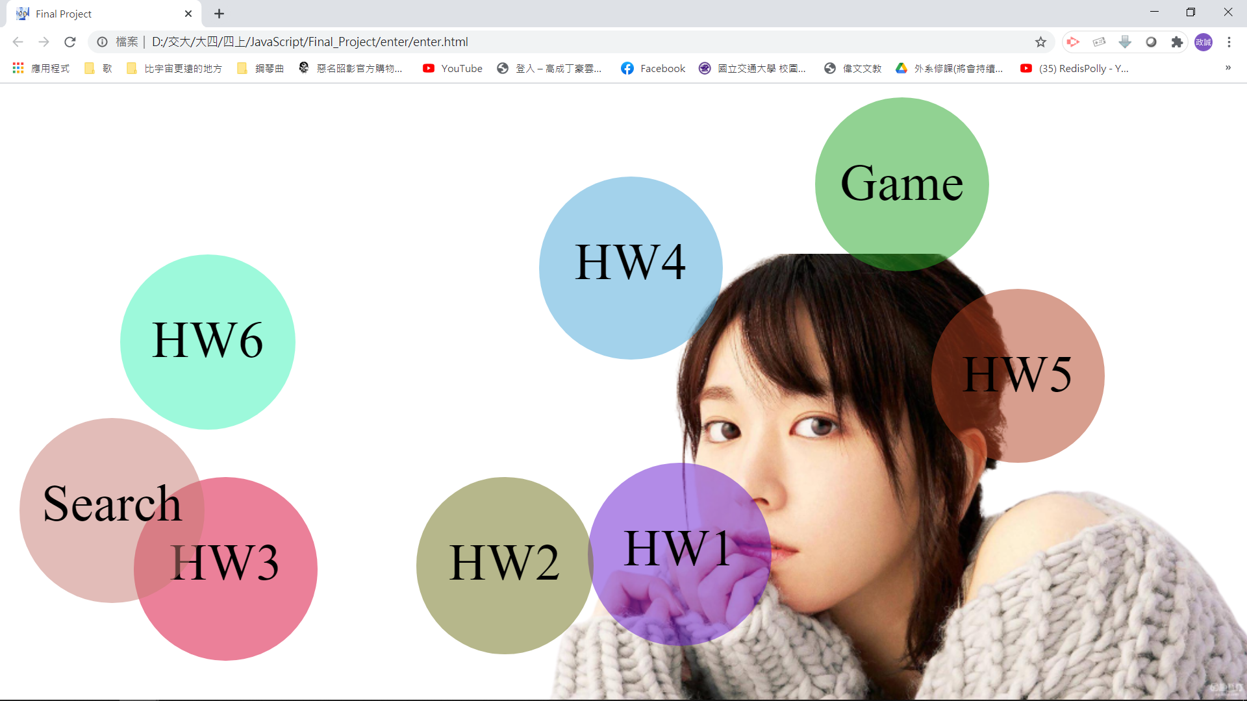
enter.html/css/js
- border-radius: 100%
- document.createTextNode
- randint - ±speed
12

Slide 13
enter.html/css/js
- distance
- click event
- e.clientX, e.clientY
- :hover, :active
Back To Homepage
Back To Previous Page
13

Slide 14
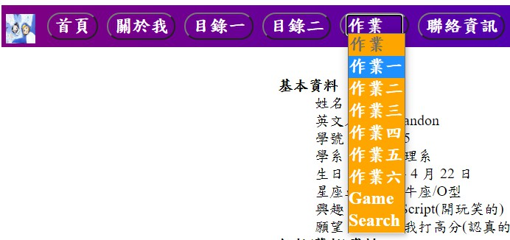
hw1.html/css/js
- option value
14

Slide 15
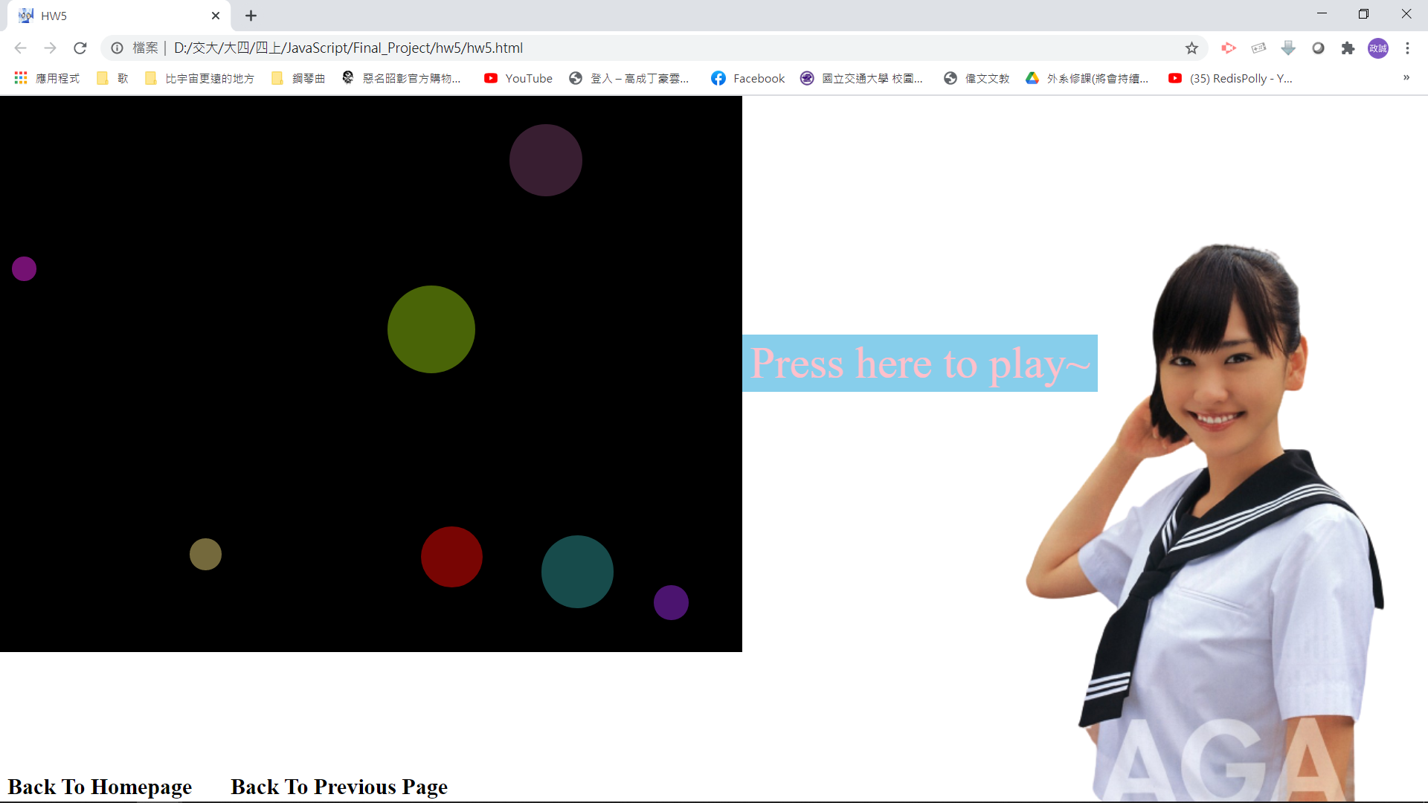
hw5.html/css/js
- input button
15

Slide 16
Functionality
Functionality & Coding Structure
Coverage => start.html
Transmission => enter.html / hw.html
Game => game.html
Animal Image Reverse Search => Search.html
16

Slide 17
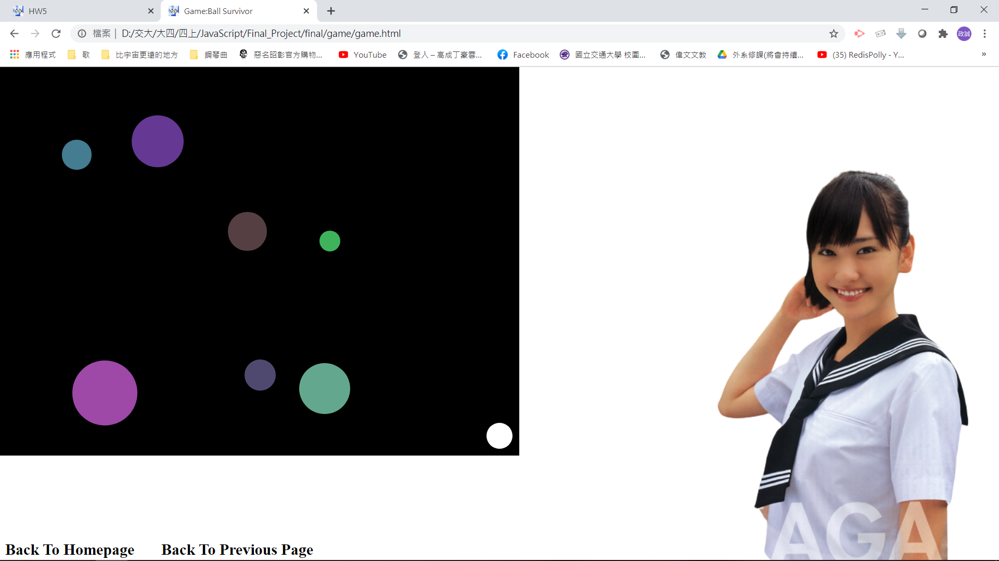
game.html/css/js
Survivor Ball
- var
- Ball()[Enemy ball]
- PlayBall()[Our ball]
17

Slide 18
game.html/css/js
Survivor Ball – move
- setInterval()
- left/.top
- keydown/up event
- Press multiple key
(Processing key clearInterval)
(Multiple key setInterval at almost the same time)
18

Slide 19
game.html/css/js
Survivor Ball – collision
- for
- distance
19

Slide 20
game.html/css/js
Survivor Ball – challenge
- var
- balls,count,point
20

Slide 21
game.html/css/js
Survivor Ball-Game Over
- radius – distance
- clearInterval()
- confirm()
- Play Again
- Homepage
21

Slide 22
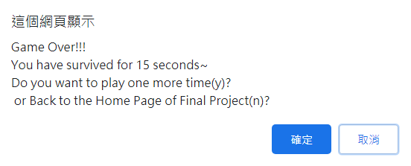
game.html/css/js
Survivor Ball-Game Over
- radius – distance
- clearInterval()
- confirm()
- Play Again
- Homepage
22

Slide 23
Functionality
Coverage => start.html
Transmission => enter.html / hw.html
Game => game.html
Animal Image Reverse Search => Search.html
23

Slide 24
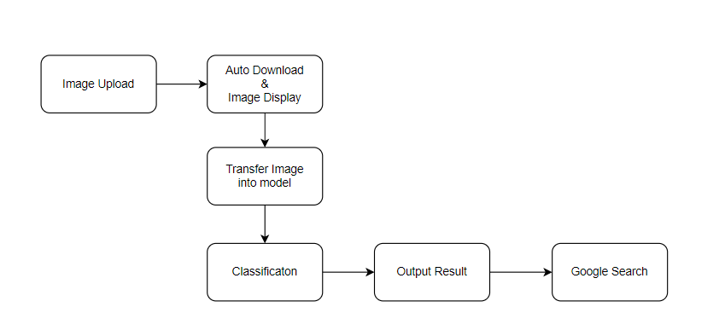
Animal Image Reverse Search
24

Slide 25
Image Upload
- Use accept to receive uploaded image
- Use onchange to trigger download & display
- Assign id = “output” to image to help grasp specific information
25

Slide 26
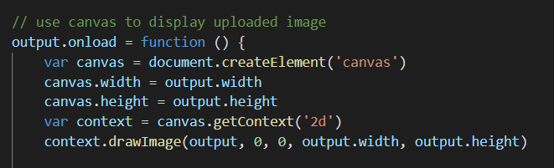
Image Display
- Create canvas and draw with info of uploaded image
26

Slide 27
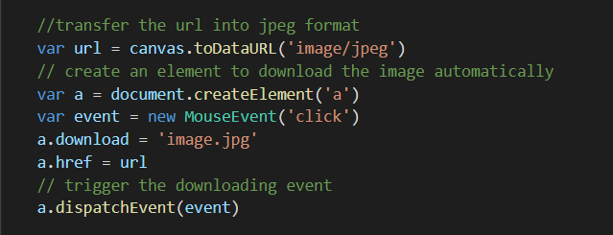
Auto Download
- Create element ‘a’ and trigger the download event
27

Slide 28
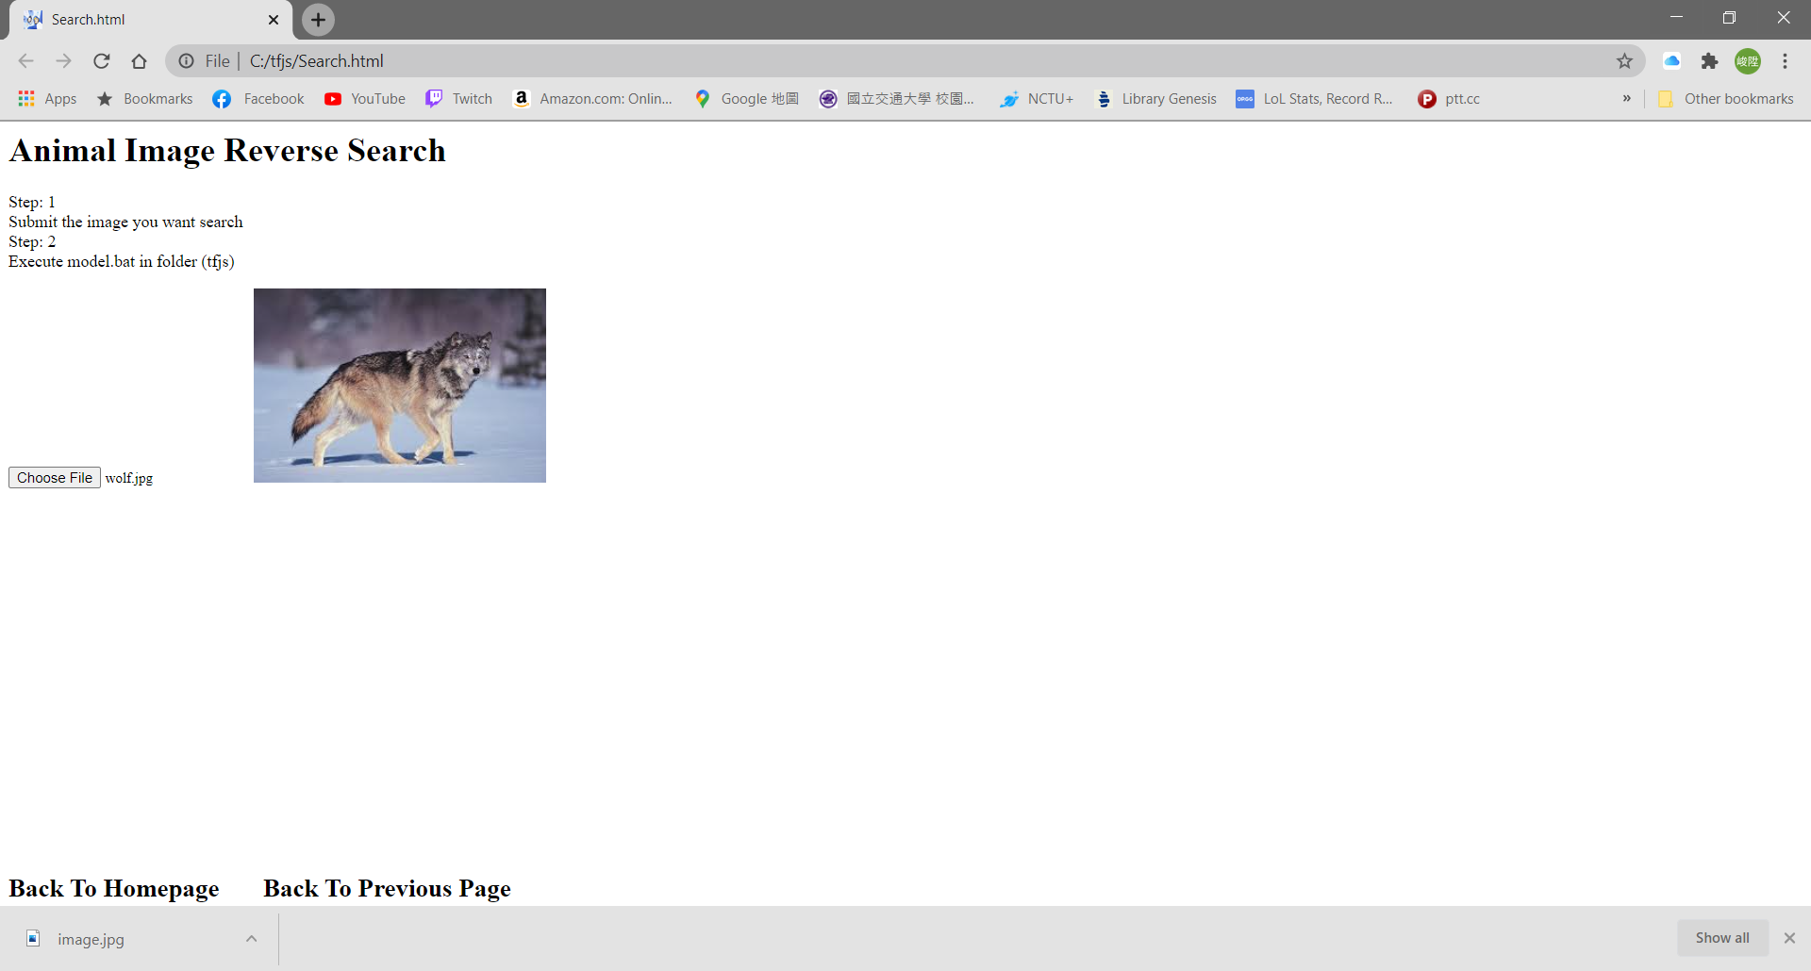
28

Slide 29
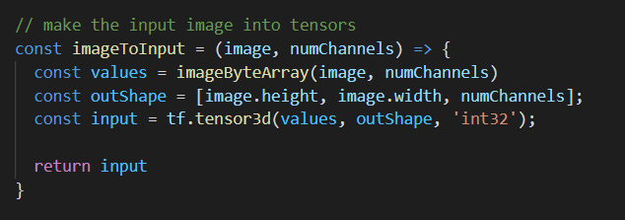
Image Transfer
- Construct predictable input image (tensor)
29

Slide 30
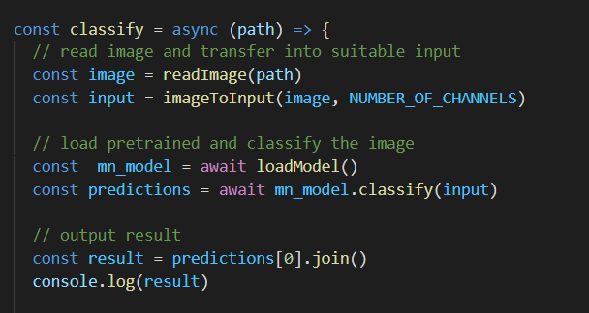
Classification & Output
Load mobilenet model with trained weights and predict
Turn the result into pure characters for easy calling
30

Slide 31
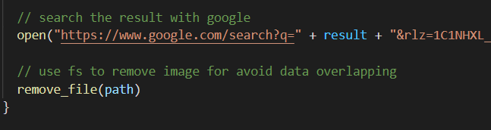
Google Search
Use open() to execute google search for the result of classification
Eliminate downloaded image to avoid target overlapping
31

Slide 32
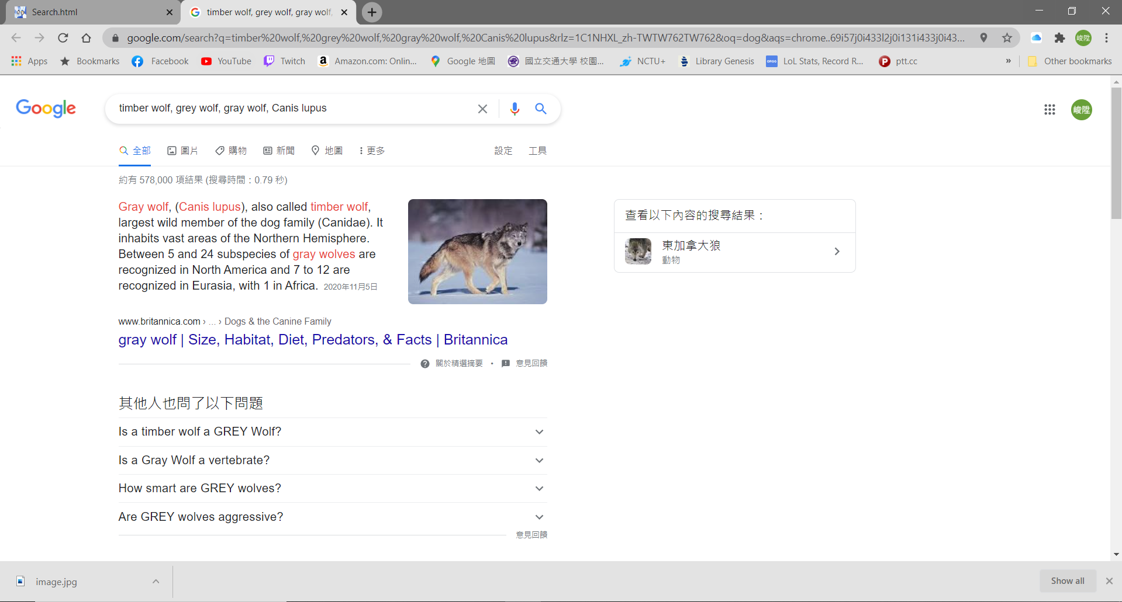
32

Slide 33
Outline
Tools & Env
Flow
Functionality & Coding Structure
4. Demo
33

Slide 34
Division of Work
林政誠:
Coverage (start)主要編寫及設計
enter主要編寫及設計
主要視窗架構和附加功能設計
網頁流程主要設計
Survivor Ball主要編寫及設計
視覺優化(css)
吳峻陞:
Search功能和畫面設
model模擬和訓練及其餘相關參數設定
nodejs相關程式編寫及環境設定
主機和網頁互動設計
視覺優化(css)
※雖然有主要負責的部分，但全部的排版及設計都有經過兩個人的討論
34

